Slide 1
2024 Point-In-Time Briefing
Regional Point in Time and Housing Inventory Count
Homeless Services Network of Central Florida

Slide 2
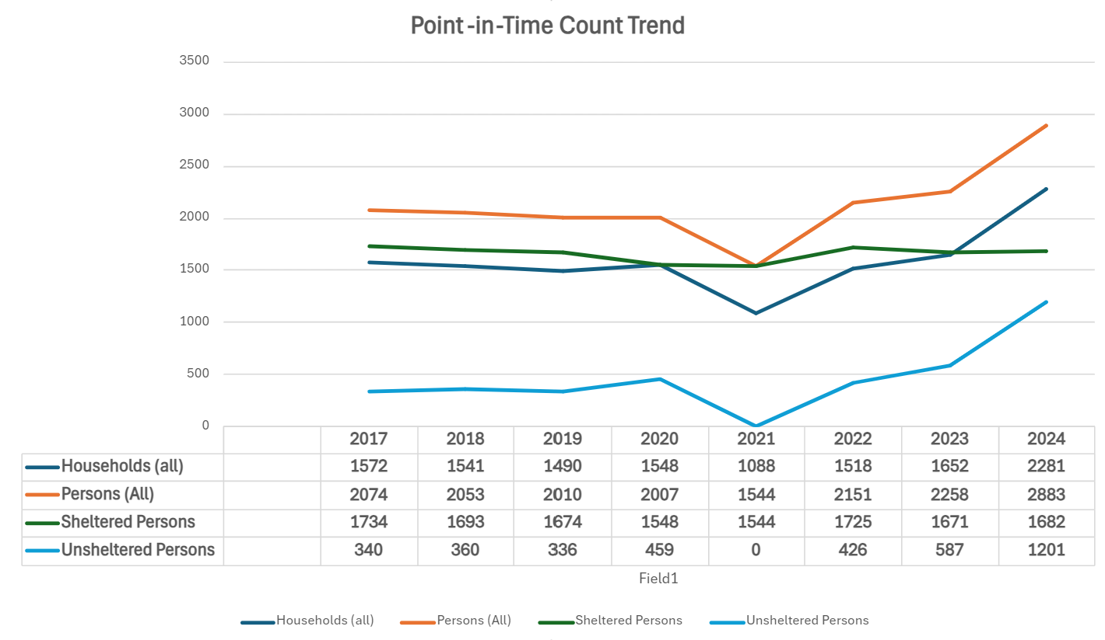
Note: No unsheltered count in 2021 due to COVID

Slide 3
Sheltered Count vs. Unsheltered Count Trend
Note: No unsheltered count in 2021 due to COVID

Slide 4
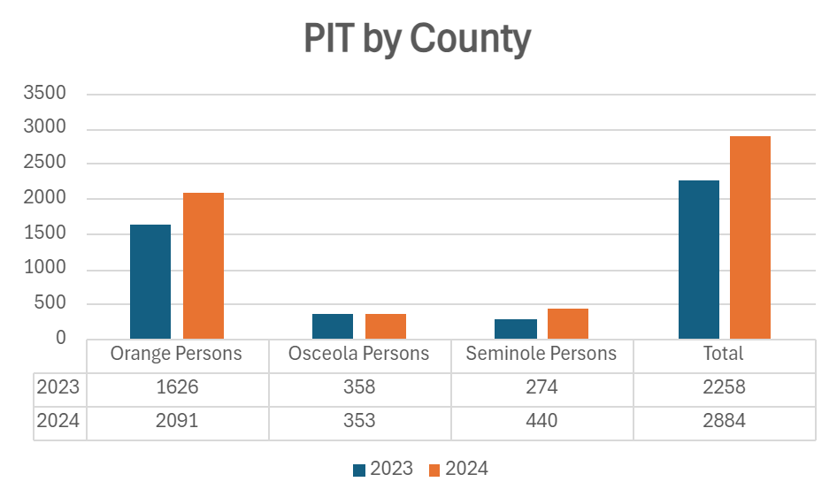

Slide 5
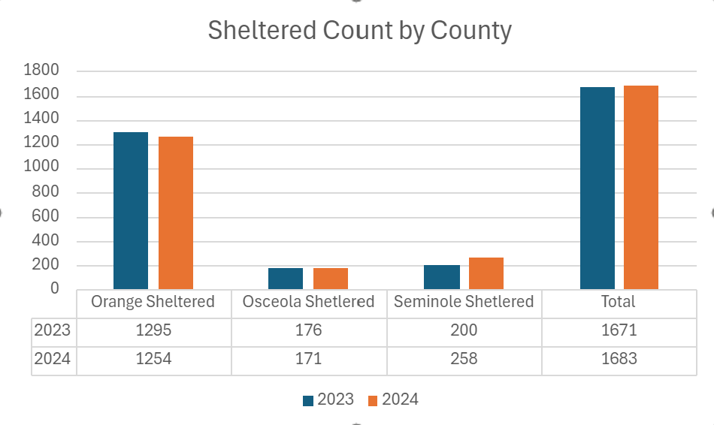

Slide 6
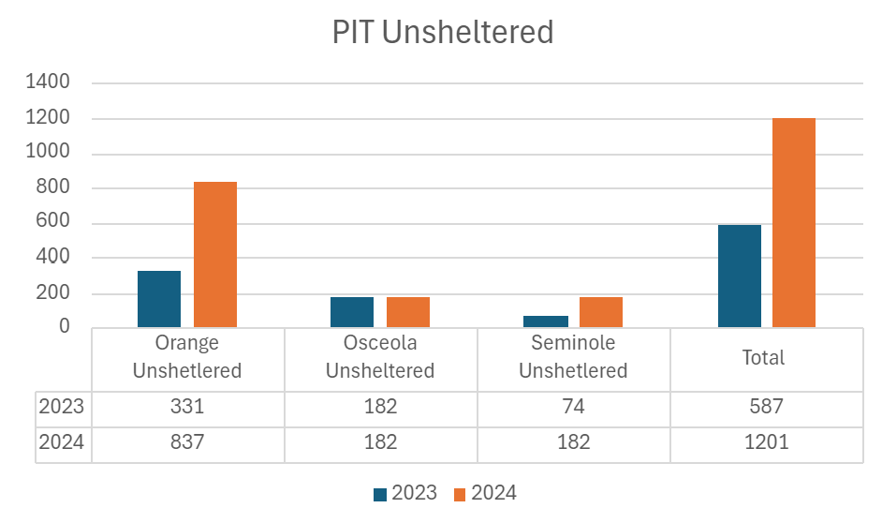

Slide 7
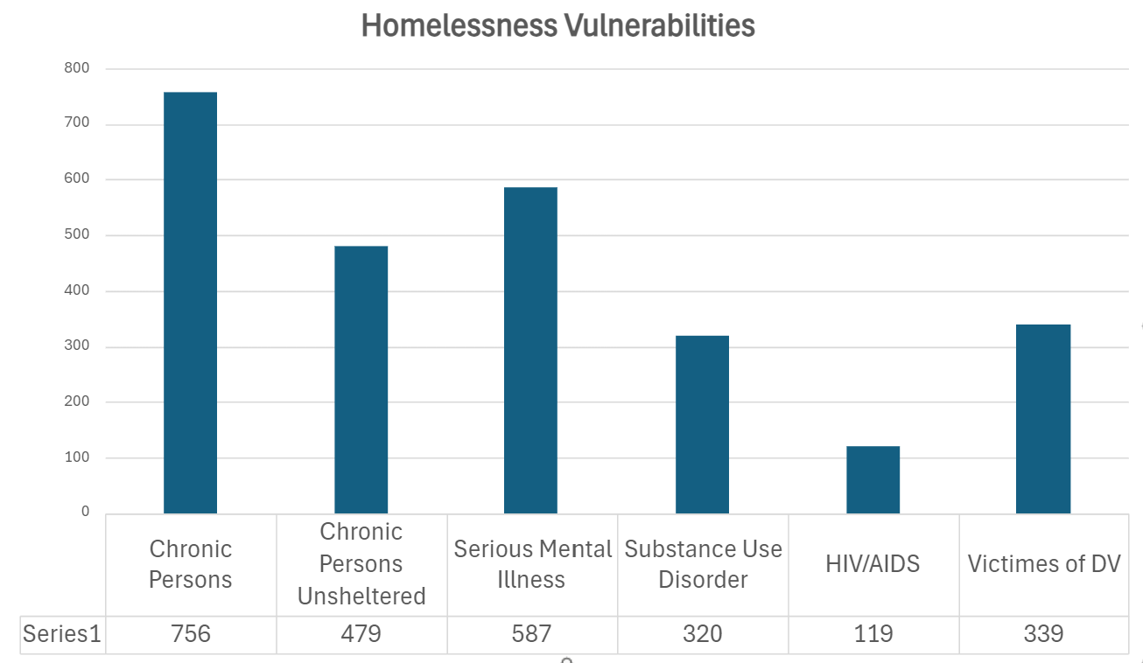
Vulnerabilities

Slide 8
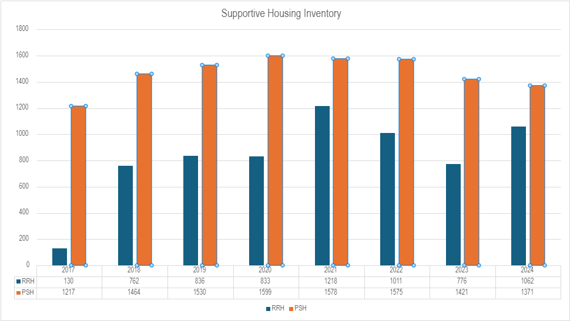
Regional Supportive Housing Inventory

Slide 9
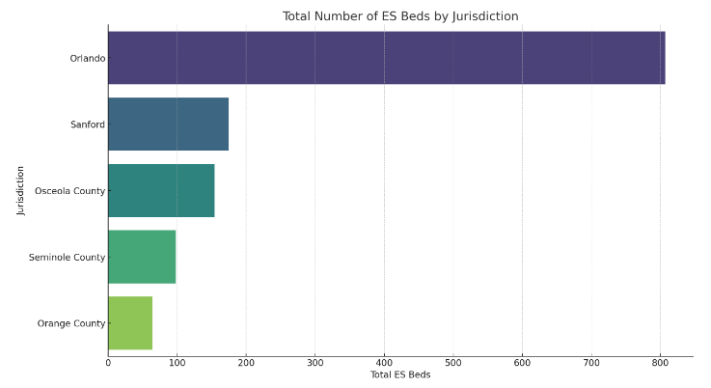
Emergency Shelter Beds by Jurisdiction

Slide 10
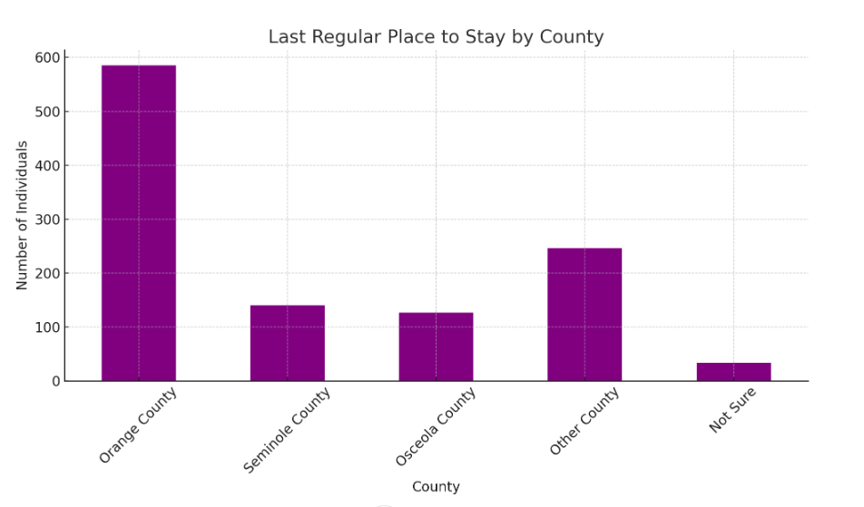
Last Regular Permanent County of Residence

Slide 11
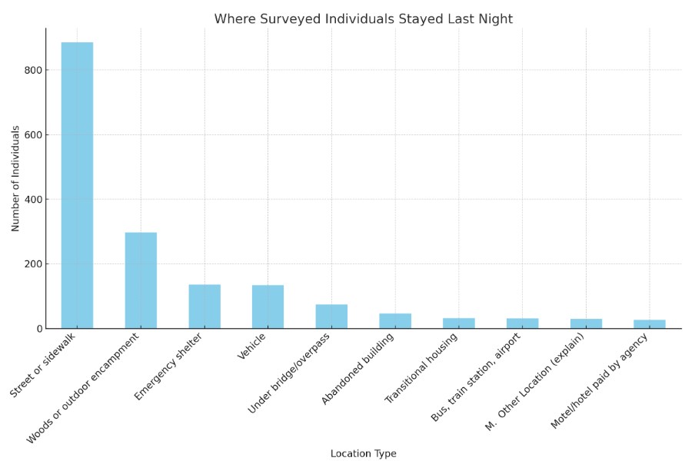
PIT Where Persons Were Staying (Regional)

Slide 12
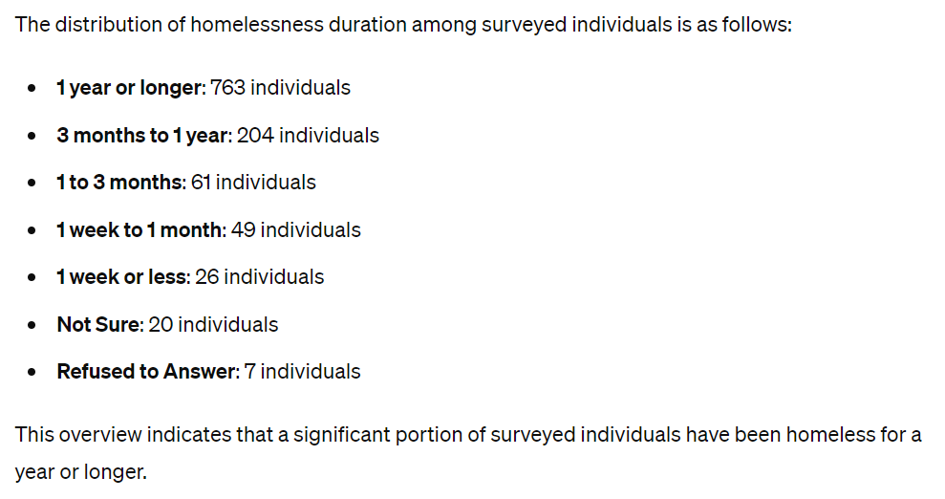
Duration of Homelessness of Unsheltered Persons

Slide 13
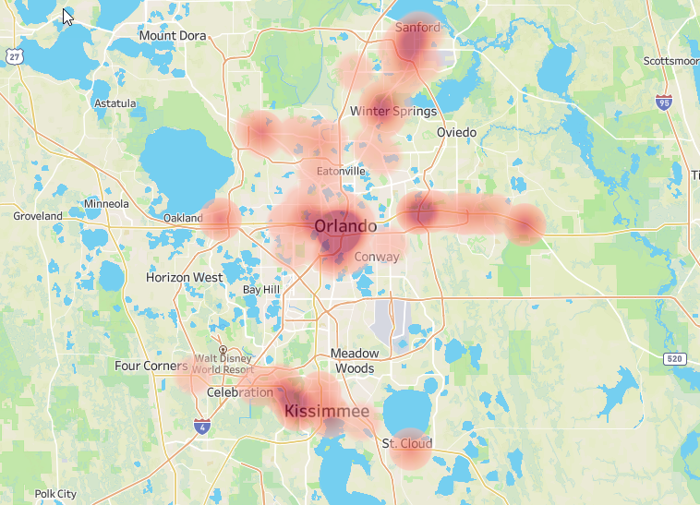
Regional View

