Slide 1


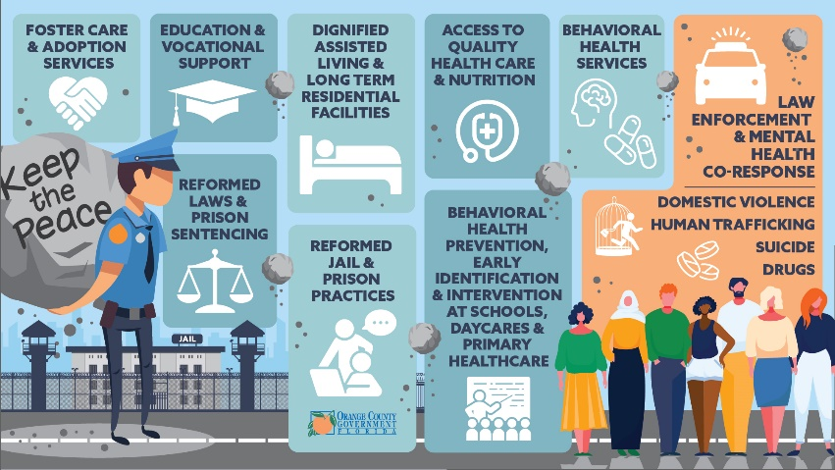
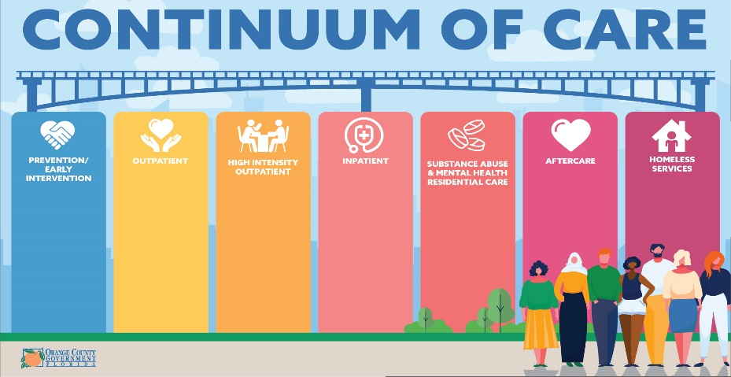
Orange County Mental and Behavioral Health System Gaps
May 18, 2021

Slide 2


Slide 3


Slide 4


Orange County Foundation
Orange County Housing For All
Mayor’s Transportation Initiative
Jail Diversion Committees
CARES Funding for Social Services
Eviction Diversion
Neighborhood Centers for Families
Primary Care Access Network

Slide 5


Mental Health and Homelessness Division Foundation
Functional Family Therapy
Modular Approach to Therapy For Children
Community-Wide Adverse Childhood Experiences Initiative
Cultural and Linguistic Competency Training
Spirit Expansion to Orange County Schools
Orange Connects
Central Receiving Center
Crisis Intervention Team Training (adults and youth)
Wraparound Orange/ System of Care Initiative
Family Support Navigation
Youth Mental Health Commission
Mobile Crisis
Spirit Navigation Platform
Breakthrough Pilot
Multisystemic Therapy Psych
Respite

Slide 6


Slide 7
Supporting Diverse Needs Through Diverse Means

Slide 8

Current System
Disjointed Navigation
Some daycare training through the Early Learning Coalition
Some community interest in advocating for becoming a trauma informed community (PJI ACES)
Baby Institute 0-5 in Parramore and Apopka
Small Nurse Family Partnership (need 4.5 more staff for full program)
General eclectic services
Not enough capacity for psychiatric services (average 1-3 month wait list)
Some MATCH and EMDR certified therapists
UCF Restores
Not enough capacity for youth- CAT Team, Dually Served and MST Psychiatric
No early childhood crisis response
Underutilized adult FIT and FACT Teams
Need for weekend and overnight respite (youth and adults)
No Psychiatric Emergency Department
Not enough beds and capacity for eligible youth and adults for residential placements 1-3
Little to no peer support for individuals leaving jail or residential facilities
File does not follow individual to new setting
Transportation barriers
Lack of capacity for Care Coordination
Severe lack of affordable housing options
Severe lack of affordable and respectable Assisted Living and Supportive Housing Facilities
Need for Transitional Living Facilities
Mental Health and Homelessness Division Behavioral Health Funding: $10,030,812 /State (Central Florida Cares) Behavioral Health Funding: *$30,921.579
*funds and individuals served reflect anyone seeking services in Orange County, not just residents

Slide 9
Current System
Some daycare training through the Early Learning Coalition
Some community interest in advocating for becoming a trauma informed community (PJI ACES)
Baby Institute 0-5 in Parramore and Apopka
Small Nurse Family Partnership (need 4.5 more staff for full program)

Slide 10
Current System
General eclectic services
Not enough capacity for psychiatric services (average 1-3 month waitlist)
Some MATCH and EMDR certified therapists
UCF Restores

Slide 11
Current System
Not enough capacity for youth - CAT Team, Dually Served and MST Psychiatric
No early childhood crisis response
Underutilized adult FIT and FACT Teams
Need for weekend and overnight respite (youth and adults)

Slide 12
Current System
No Psychiatric Emergency Department

Slide 13
Current System
Not enough beds and capacity for eligible youth and adults for residential placements 1-3

Slide 14
Current System
Little to no peer support for individuals leaving jail or residential facilities
File does not follow individual to new setting
Transportation barriers
Lack of capacity for Care Coordination

Slide 15
Current System
Severe lack of affordable housing options
Severe lack of affordable and respectable Assisted Living and Supportive Housing Facilities
Need for Transitional Living Facilities

Slide 16
Current System
Mental Health and Homelessness Behavioral Health Funding: $10,030,812 (4,131 individuals and families served, approximately 10,000 impacted)
State (Central Florida Cares) Behavioral Health Funding: $30,921,579* (14,309 individuals and families served)
*funds and individuals served reflect anyone seeking services in Orange County, not just residents

Slide 17
Needed System
Providers Needs/Costs
Community Assessment-Driven Navigation
High Functioning Systems
SAMHSA System of Care Expansion Grant $1mil
Add 4.5 positions to Nurse Family Partnership Program $441k
Peer Respite $450k
Caregiver overnight and weekend respite $1mil
CIT Expansion $172k
24/7 Drop-In Centers with substance abuse mental health overlay $900k
Adult Mobile Crisis $1mil
Early Childhood Mental Health Consultation 300 daycares $27mil
Wide spread training in evidence based practices to mental health providers $1mil
More psychiatric providers $1mil-$5mil
Increased capacity for care coordination and case management $680k
Indigent Drug Program $12k
Additional teams for MST Psych $630k , CAT $750k and Dually Served $500k
Psychosocial Rehab $2.2mil
Psychosocial Rehab Assisted Outpatient Treatment $750k
Medication Assisted Treatment $325k
Adult Intensive Outpatient Services $1mil
Psychiatric Emergency Department $330k
Increased capacity for youth and adult residential units levels 1-3 $2.6mil
Peer Support $455k
Increased Care Coordination and Case Management $680k
30,300 affordable and attainable Housing (refer to Housing for All 10 year plan- $160mil over 10 years)
Supportive Housing
Assisted Living Facilities
Transitional Living Facilities
= $330k
= $2.6mil
= $1.1mil
Substance Abuse, Family, Youth and General MH Peer Support
Trauma Center
Culturally and Linguistically Competent System
Consumer driven voice and choice
Expanded training and credentialing in high fidelity Evidence Based Practices
Data driven decision making
Federal to state level policy decisions/ Medicaid Expansion
Physical space to support needed services
Substance Abuse, Family, Youth and General MH Peer Support
Trauma Center
Culturally and Linguistically Competent system
Consumer driven voice and choice
Expanded training and credentialing in high fidelity
Evidence Based Practices
Data driven decision making
Federal to State level policy decisions/ Medicaid Expansion
Physical space to support needed services
= $?
= $?
= $6.2mil
= $2.7- $6.7mil
TOTAL NEED: $49mil
= $32mil

Slide 18
Needed System
SAMHSA System of Care Expansion Grant - $1mil
Add 4.5 positions to Nurse Family Partnership Program - $441k
Peer Respite - $450k
Caregiver overnight and weekend respite - $1mil
CIT Expansion - $172k
24/7 Drop-In Centers with substance abuse mental health overlay - $900k
Adult Mobile Crisis - $1mil
Early Childhood Mental Health Consultation 300 daycares - $27mil
= $32mil

Slide 19
Needed System
Wide spread training in evidence based practices to mental health providers - $1mil
More psychiatric providers - $1-$5mil
Increased capacity for care coordination and case management - $680k
Indigent Drug Program - $12k
= $2.7- $6.7mil

Slide 20
Needed System
Additional teams for MST Psych $630k, CAT $750k and Dually Served $500k
Psychosocial Rehab - $2.2mil
Psychosocial Rehab Assisted Outpatient Treatment - $750k
Medication Assisted Treatment - $325k
Adult Intensive Outpatient Services - $1mil
= $6.2mil

Slide 21
Needed System
Psychiatric Emergency Department $330k
= $330k

Slide 22
Needed System
Increased capacity for youth and adult residential units levels 1-3 - $2.6mil
= $2.6mil

Slide 23
Needed System
Peer Support - $455k
Increased Care Coordination and Case Management - $680k
= $1.1mil

Slide 24
Needed System
30,300 affordable and attainable Housing (Housing for All 10 year plan- $160mil over 10 years)
Supportive Housing
Assisted Living Facilities
Transitional Living Facilities
= $?

Slide 25
Needed System
Community Assessment-Driven Navigation
Substance Abuse, Family, Youth and General Mental Health Peer Support
Trauma Center
Culturally and Linguistically Competent System
Consumer driven voice and choice
Expanded training/credentialing in high fidelity Evidence Based Practices
Data driven decision making
Federal to state level policy decisions/ Medicaid Expansion
Physical space to support needed services
VALUES OF HIGH FUNCTIONING SYSTEMS
TOTAL NEED: $49mil

Slide 26
Short Term Recommendations
Full time CIT Coordinator to train trainers, collect data and expand CIT Training ($172k), Mindfulness Training ($12k ), CIT Echo (free) = $184k total (600 additional first responders and corrections officers trained. Currently 150 are trained annually)
Adult Mobile Crisis = $1mil total (new initiative)
Adult intensive outpatient ($230k, new initiative to serve 24 people), Assisted Outpatient Treatment and Psychosocial Rehabilitation ($750k, new initiative to serve 38 people), Medication Assisted Treatment ($325k, expand to 25 non-incarcerated individuals) = $1.3mil total and 87 people served
Evidenced Based Practices in outpatient services that support people staying in the community = $1mil total (new initiative)

Slide 27

Short Term Recommendations
Increase capacity pre and post booking Peer Support = $900k total (new initiative)
Drop-in Centers with Mental Health and Substance Abuse overlay = $900k total (new initiative)
Psychiatric ED = $330k total (new initiative)
Substance abuse and mental health residential services levels 1-3 = $3.3mil total (63 additional people. Current capacity is 102)
SHORT TERM NEED: $9mil

Slide 28
Long Term Recommendations
Affordable housing, supportive housing, assisted living and transitional living facilities = $?
Prevention, early identification and intervention: disrupt the prenatal to prison pipeline
  SAMSHA Grant Expansion = $1mil (new initiative to serve 150 families)
  Nurse Family Partnership = $441k (serve an additional 26 families, up from 26)
  Caregiver overnight respite = $1mil (new initiative)
  Early Childhood Consultation = $27mil (new initiative)
LONG TERM NEED: $29.4+mil

Slide 29

Heart of Florida United Way - Selection
Not a direct service provider - can provide an objective perspective
Experienced in working with service providers, consumers and corporate partners
Experienced in supporting Orange County through times of crisis:
    Operation of Orlando United Assistance Center after the Pulse Shooting
    Assist evacuees from Puerto Rico after Hurricane Maria

Slide 30
Heart of Florida United Way – Scope of Work
Convene the Mayor’s stakeholder group to vet and review Orange County Gaps Analysis
Oversee ongoing stakeholder involvement
Identify funding duplications, opportunities and service funding gaps from the perspective of alignment
Ensure community groups create plan
Hire a consultant to validate findings and work with community groups
Deliver a strategic plan to create a high performing behavioral health system that includes financial sustainability

Slide 31
Heart of Florida United Way – Schedule/Budget
Schedule: 8 months
Budget: $315,480
Contract will be funded through the American Rescue Plan

Slide 32
Requested Action
Approval of the Scope of Work Proposal and Funding in the amount of $315,480 for the Heart of Florida United Way to undertake a Mental and Behavioral Health System of Care Community Analysis using, in part, Orange County’s Mental Health and Homelessness Division’s Continuum of Care Report and authorization for the County Administrator to execute a contract with Heart of Florida United Way.

Slide 33
Orange County Mental and Behavioral Health System Gaps
May 18, 2021

